Slide 1
Sentiment Analysis and Topic Detection for Fake News Classifier
Team Members:
Foo Chuan Geng
Loh Xiao Binn
Toh Ying Hui
Moh Qing Loong Darren
Notes:
Hello everyone, we are group 4 and we will be working on a fake news classifier model using logistic regression, sentiment analysis and topic detection. Our project title is Sentiment analysis and topic detection for fake news classifier.

Slide 2

TABLE OF CONTENTS
3. Project Topic and Title - Details
4. Problem Statement
6. Motivation 7. Datasets 9. Literature Review 10. Methodology
11. Tools and resources DM/ML Techniques (website, references, package name, references)
13,14. Preliminary Results, Evaluation
17. Project Milestones
18,19. References 20. Q&A
Notes:
This will the flow of our presentation

Slide 3

Project Details (an overview)
01
02
03
TARGET
PROJECT TITLE
Sentiment Analysis and Topic Detection for Fake News Classifier
OUR PROCESS
Sentiment Analysis & Topic Classifier
-> Fake News Classifier
Identifying fake news & Understanding the trends in Fake News
Notes:
Here’s an overview of our project, the process we will be adopting, is to work on a fake news classifier model and then build 2 other models, 1 for topic detection and another for sentiment analysis and see if they improve the fake news classifier model. Through this, we hope to be able to better identify fake news and understand its trends.

Slide 4
Problem statement
The plethora of misleading false information in this time where data is highly accessible causes confusion and frustrations to both individuals and businesses.
Notes:
In the increasingly connected world, we have so much freedom to create and to access information online. This makes the web what was once a safe place to make important announcements and obtain resources now a dangerous trap that will not only create confusion but also problems for many individuals and businesses.

Slide 5
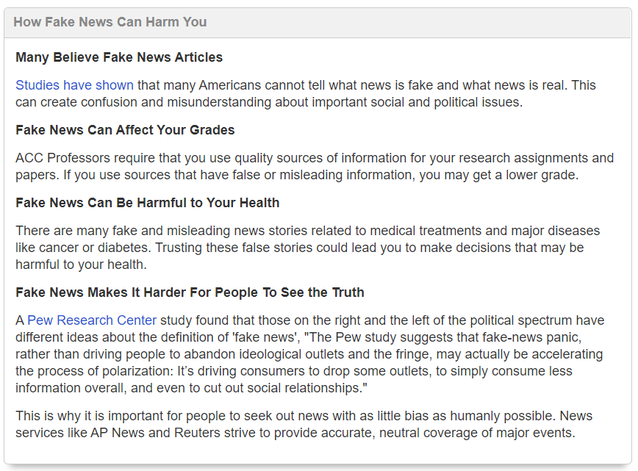
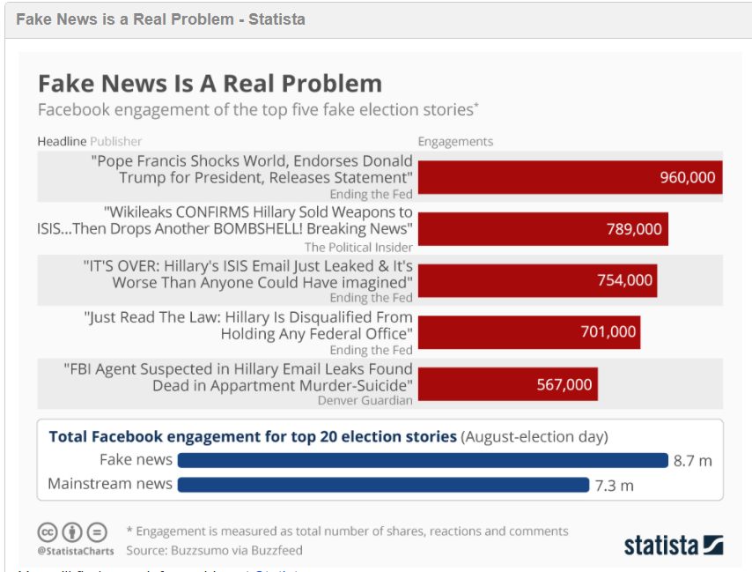
Notes:
Here are some examples that explain why fake news is harmful. For us students, fake news can affect our grades, imagine if we use a misleading resource as a reference. In this time where we are more careful about our health, there are many health resources available online, which could be taken as medical advice. How will we be able to tell what’s right or wrong? As such, the problem of identifying fake news is ever so relevant to us.

Slide 6


Motivation - UNDERSTANDING THE PROBLEM
Fake News
Real News
We want to identify fake news from a large dataset and understand trends in fake news.
We must learn to identify true information and it will be easier if we understood the trends in false news. For example, a hypothesis could be that political news is more likely to be false.
Notes:
In order to use our great access to resources well, we must learn to differentiate what’s real and what’s not. In this project, we want to take it one step further to also work on studying the trends in false news. For example, a hypothesis could be “political news is more likely to be false” or “political news about Donald trump with a positive sentiment is more likely to be false” . Understanding patterns like this will also help us visualize networks which will help us understand the context of our analysis better.

Slide 7
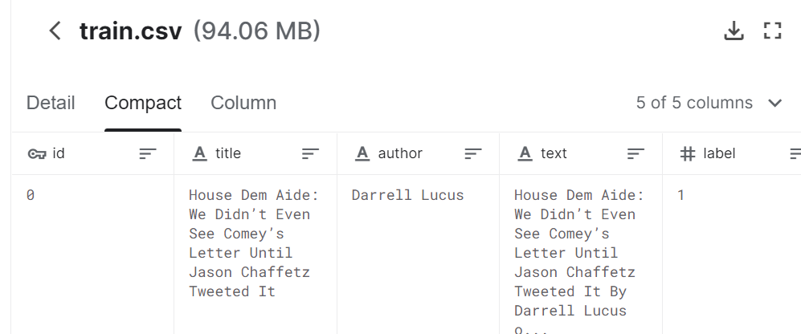
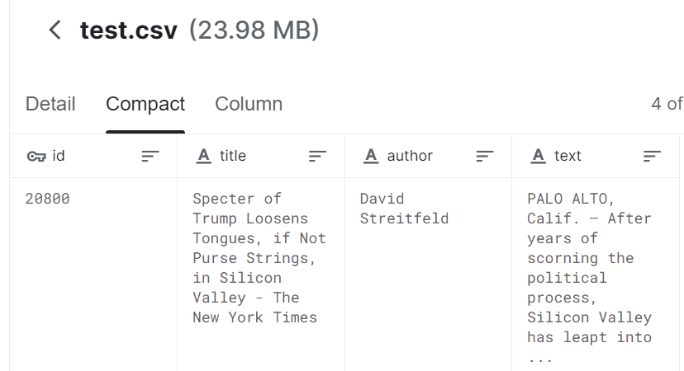
Datasets
Obtained from Kaggle (https://www.kaggle.com/c/fake-news/data).
Contains a total of 20,800 records and 5 variables: id’, ‘title’, ‘author’, ‘text’ and ‘label’.
For test data, there are a total of 5,200 rows.
Notes:
Our datasets are obtained from Kaggle, and there are 2 different files, one for training data and one for the test data. For the training data, there are a total of 20,800 records, Both the training and test data have the variables, “id”, “title”, “author”, “text”. As for “label”, only the training dataset has that variable.
We replace the missing data with a space as for the test set, we have to maintain 5200 rows in order for the csv file to be uploaded to Kaggle to see
The accuracy for the test set. So to clarify, we will be submitting thru Kaggle to test the accuracy.

Slide 8
Training & Test dataset (fake news classifier)
Field Name | Data Type | Description
id | int64 | Unique ID for a news article
title | object | The title of a news article
author | object | Author of a news article
text | object | The text content of the article (may be incomplete)
topic | string | Category of news
sentiment | integer | Neutrality from title
label | int64 | A label that marks the article as potentially unreliable 1: unreliable 0: reliable
From topic classifier model and sentiment classifier model
* Test data is not labelled
Notes:
* Objects are converted to string
This is the high level breakdown of our dataset. As described here, as part of our analysis, we will obtain the labels for topic and sentiment after running the dataset through the respective models and adding them into the dataset which will be used to train the fake news classifier, the results of which we will compare with the fake news classifier without these layers and assess.

Slide 9
Literature review
Fake News Classifiers (Supervised) | Sentiment Analysis | Topic Detection (Unsupervised)
KNN(K-Nearest Neighbour) | SVM(Support Vector Machine) | SVM, Personalized
SVM(Support vector Machine) | KNN(K-Nearest Neighbour) | Elasticsearch (based on business rules, not ML)
Random Forest | Rule based lexicon (NRC, SentiWordNet) | Logistic Regression
Naïve bayes | Random Forest Classifiers | CatBoost with default VoW embeddings
GWO(Grey Wolf Optimisation), SSO(Salp Swarm Optimisation) | Ensemble of label powerset classifiers | CatBoost on TF-IDF features
Logistics regression | Vader, Textblob | Naïve Bayes , Hidden Markov Model
Notes:
KNN groups similar words items into k groups based on similarity (distance) and classified at the end.
SVM classify the fake news/ emotions using hyperplane of maximum distance from data points of classes
Random Forest creates many decision trees that operate as an ensemble, the model with the most votes becomes the fake news prediction model e.g. ranking feature importance of the different words that may lead to fake news
Naive Bayes does its classification of fake news based on the probabilities of the independent-assumed features(e.g words) to decide documents belong to which news category, e.g. calculate the words that have the most indication of being in fake news and the words that have the most indication of being in real news, which is then linked to the real-world context
Logistics regression helps to give a baseline score for classifying/detecting fake news
Newly ventured areas comprises of GWO, SSO, where they are used to detect fake news problem with unstructured textual social media data, they differs from other algorithm where their models can be used to explain how it works, when others are operating as black-box models. They have a flexible fitness function that allows different objectives to integrate into the model. Also, they outperformed other techniques used.
In Sentiment analysis, emotions are classified based on polarity or classified under specific emotions. ML algorithms used to derive sentiments are SVM, KNN, rule based, ensemble of label powerset classifiers(Each LP learns one single classifier with k possible labels, where k ≤ k and is trained using a different small random subset of all emotions, a test instance is classified by combining votes from individual LP classifiers such that it is labeled with an emotion if the average vote of all classifiers is greater than a user-specified threshold), Random Forest classifiers, lexicon(NRC, SentiWordNet provides each word with a decimal signed polarity degree), Vader (gives 4 scores..positive, negative, neutral, combined rating normalised), TextBlob (positive, negative, subjectivity)

Slide 10
METHODOLOGY
Topic Modelling
Sentiment Analysis
Analysis
Fake News Classifier
e.g. Politics, Sports, Health, Crime, etc.
Positive, Negative, Neutral
Trends and characteristics of fake news
Binary (0,1)
We will be using the same dataset for all 3 models & the output of the sentiment analysis and topic classifier will be used to train the fake news classifier model.
Notes:
What is your method or your solutions; describe your method in details..
For our project , we want to study and understand if factoring attributes from topic modelling and sentiment analysis
will it affect the fake news classification model which we will be building,
Either it will strengthen our/ weaken classification model
So over here, it shows our process flow,
0. After our EDA and text pre processing
So firstly we will pass the text data to the sentiment analysis toolkit [unsupervised methods] where the output will give us sentiment polarity
We will also pass the text data to the topic modelling [unsupervised learning methods] where the model can help us cluster the data into different topics
We will feed the processed text data , output from sentiment and topic modelling into the classifier to train the model, evaluate whether model improve / worsen.
1: unreliable
0: reliable
And we will be comparing with a baseline model which I will show u later
Also we will conduct some analysis :
To see what kind of characteristic and trends does fake news data set possess based on the topic modelling and sentiment analysis

Slide 11
Tools and Resources:
General
NLTK, Pandas, numpy, sckit-learn
Sentiment analysis [tools]
Textblob & NLTK-Vader package
Topic modelling [unsupervised]
LDA [from Gensim], K-means, Density based [DBSCAN]
Fake news Classifier
Naïve Bayes, SVM, Logistic Regression, Random forest
Metrics
Cross Validation [K-folds], Confusion Matrix
Notes:
What DM technologies you use ?
So to build the models we require some tools and resources to help us, so over here is the list of them
1. General - libraries, NLTK for text processing, scitlearn for some of the ml models
2. Sentiment analysis – unpervised methods which we will have toolkit such as
Textblob - TextBlob uses a weighted average sentiment score over all the words in each sample.
Vader – VADER seems to work better with things like Capital letters, slang, emojis, etc — whereas TextBlob performs strongly with more formal language usage.
https://medium.com/@andronikmk/sentiment-analysis-with-nltk-textblob-and-flair-a321d1460867
3. Topic modelling: [unsupervised model]
LDA – Goal: Is to Map all documents to the topics so that that words in each text are mostly captured by the topics
However, Need specify no of topics, and also it cannot name list out the topic name, but will mention the most likely words that belong to each topics
K means - need specify no of topics [K], but show the list of topic names
Density based - do not need to specify the number of topics you are looking for, as you do with K-means or LDA. Will list the topic names
4. Fake news classifier – all from scitlearn
5. Metrics – Cross validation [accuracy] and confusion matrix to evaluate the models
For text processing purposes so that it can be feed into the tools that we are using, and the machine learning models – NLTK
Explain why we use both textblob and vader . Explain further that we will be building both and doing comparison.
===================================
Sentiment analysis
Following are unsupervised methods that employs rule – based approach to analyze a text
We will be using prebuilt libraries follow lexical based approach
Lexical - relating to the words or vocabulary of a language.
Lexical words are those that have independent meaning (such as a Noun (N), verb (V), adjective (A), adverb (Adv), or preposition (P).
TextBlob –
- polarity between -1 and 1
- The subjectivity is TextBlobs score of whether the statement is deemed as more opinion, or fact based. A higher subjectivity score means it is less objective, and therefore would be highly opinionated.
TextBlob uses a weighted average sentiment score over all the words in each sample. This easily diffuses out the effect of sentences with widely varying polarities between words in our case : ‘helpful’ and ‘but’.
NLTK - Vader [Valence Aware Dictionary and Sentiment Reasoner] -
Output polarity scoring in 3 classification levels and a compound score
compound score — which is a “normalized, weighted, composite score” flags it as a very negative statement.
https://medium.com/ro-data-team-blog/nlp-how-does-nltk-vader-calculate-sentiment-6c32d0f5046b
VADER vs TEXTBLOB :
VADER seems to work better with things like slang, emojis, etc — whereas TextBlob performs strongly with more formal language usage.
https://medium.com/@andronikmk/sentiment-analysis-with-nltk-textblob-and-flair-a321d1460867
======================
Topic modelling – [unsupervised method]
The task of Identify topics that best describe a set of texts
LDA [Latent Dirichlet Allocation] – unsupervised learning methods,
Each topic represents a set of words
Goal of LDA: Is to Map all documents to the topics so that that words in each text are mostly captured by the topics
Each document can be described by a distribution of topics and each topic can be described by a distribution of words
Need specify no of topics, and also it cannot name the discovered topics , but will mention the most likely words that belong to each topics.
Reference:
https://towardsdatascience.com/light-on-math-machine-learning-intuitive-guide-to-latent-dirichlet-allocation-437c81220158
K means - need specify no of topics, but show the list of topic names
Density based [DBSCAN]- do not need to specify the number of topics you are looking for, as you do with K-means or LDA. Will list the topic names
=============================
Fake news classifier
Metrics - Cross validation K folds – use to compare accuracy among the model that we have build
https://medium.com/@rajputankit22/cross-validation-machine-learning-models-with-scikit-learn-1a8d87441bd0#:~:text=Cross%2Dvalidation%20is%20a%20technique,failing%20to%20generalize%20a%20pattern.
https://medium.com/datadriveninvestor/k-fold-cross-validation-6b8518070833
Difference between LDA and K means that K means will partition text in a disjoint cluster [by topics], LDA assigns a text to a mixture of topics , therefore one texts will be characterized by one or more topics
Therefore LDA can give a more realistic results.

Slide 12
Machine Learning Techniques
Logistic Regression
Support Vector Machine
Naïve Bayes
Random Forest
To cluster fake news into different topics
To give us a baseline score for classifying/detecting fake news
To distinctly classify the fake news/ emotions using hyperplane of maximum distance from data points of classes
To classify fake news based on the probabilities of the independent-assumed features(e.g words) to decide documents belong to which news category
K means clustering
To give a number of decision trees that operate as an ensemble, the model with the most votes becomes the fake news prediction model

Slide 13
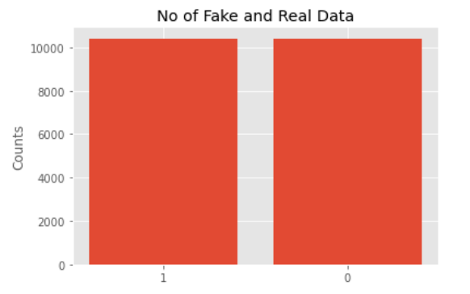

Preliminary results of Baseline model (EDA and Text Processing)
No of Fake and Real dataset labels
Notes:
We did some preliminary EDA to see our training data labels
To see whether is it a balanced dataset

Slide 14
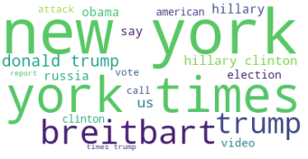
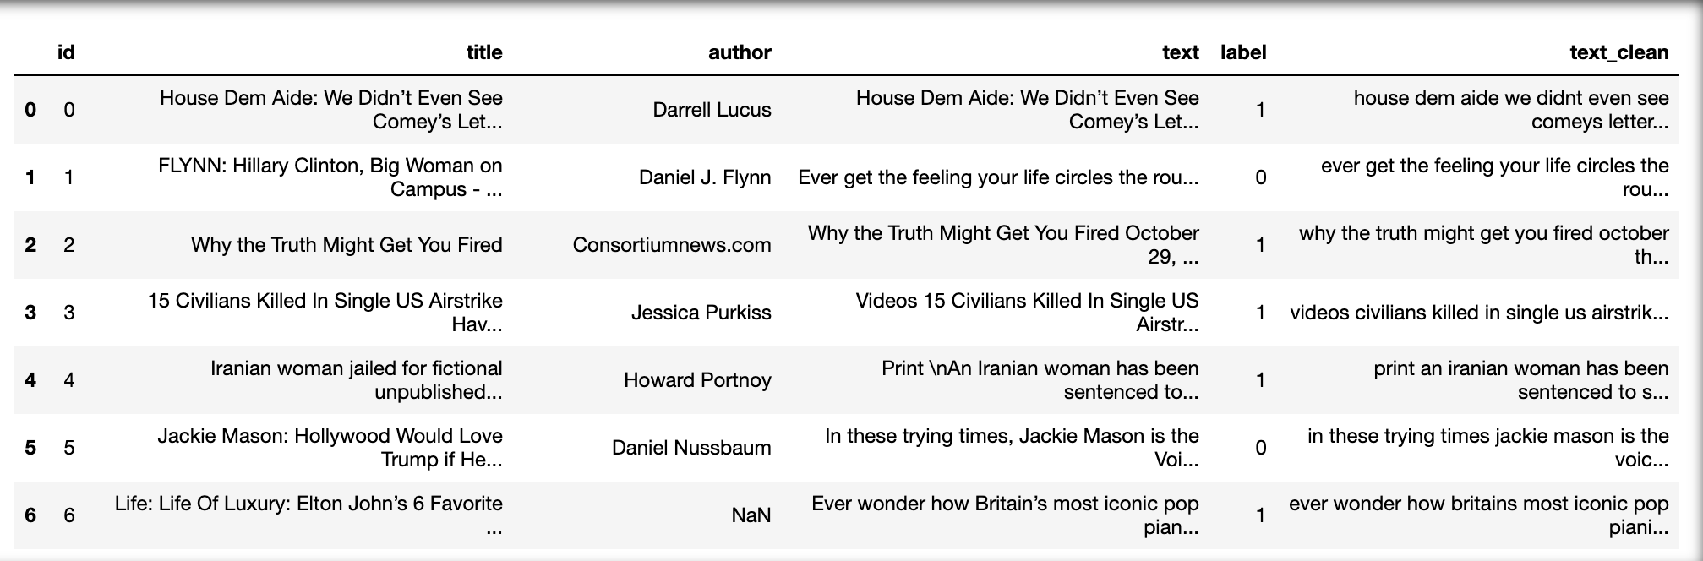
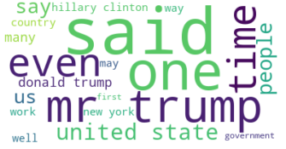
Preliminary results of Baseline model (EDA and Text Processing)
Top 20 most common words in title
Performed text processing to remove stopwords, tokenize the words and stemmer to prepare as input to the baseline models
Top 20 most common words in text
Notes:
Pre processing our data to prepare for the input to be feed into our baseline model
Remove stop words
Tokenize words
Apply Stemmer
After we pre process the data, we use feed into word cloud

Slide 15
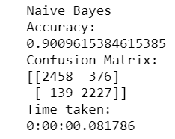
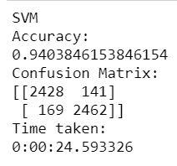
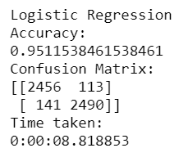



Preliminary results and evaluation (Baseline Model)
Respective output for preliminary models for Fake news classification before adding topic/sentiment analysis in increasing accuracy rate (from left to right).
Logistic regression gives the best accuracy of 95.1
Notes:
We should try to add charts/diagrams WITH captions , taking reference from academic reports……….
Apply fit transform on the text data using count vectorizer
Pass thru the 3 models , Naïve bayes, SVM and logistic regression so that use them as a baseline score
As u can see from the result:
Logistic regression achieve the highest score as compared to the rest
when we submit the lablled prediction on Kaggle
For the confusion matrix,

Slide 16
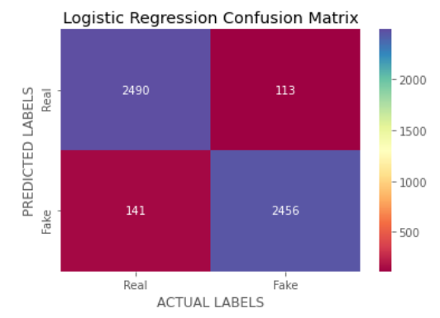
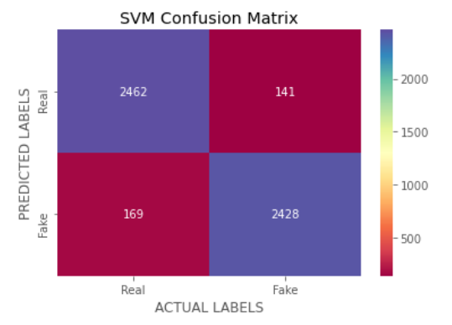
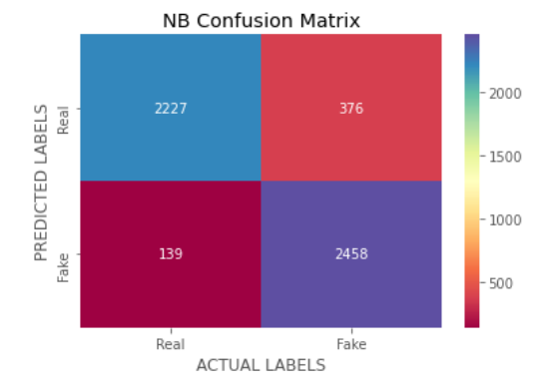
Preliminary results and evaluation (Baseline Model)
https://github.com/chuangeng555/fakenewseda/blob/master/fake_news.ipynb
Notes:
Evaluation of the model we use the confusion matrix
Log regression and SVM are almost on par when it comes predicting the correct class label
NB did not perform as well as compared to

Slide 17
Project Milestones / Tentative Schedule
Literature review + deciding which models to use
Compare, streamline and choose best models. Explore further analysis about trends & improve model if possible
Data sourcing & Topic selection
Proposal
Presentation
Week 4
Week 6
Week 8
Week 11
Week 3
Week 5
Week 7
Start to build and train Models, consolidate results & findings
Week 9
Prepare for Final presentation + Report completion
Create proposal slides + Literature review + Further data cleaning
Dataset standardization + Exploratory Data Analysis
Notes:
We will start to train our sentiment and topic modeling to feed into the classifier models
Compare among them and choose the best model to compare with the baseline model
And if time permits, we will try to improve it if possible

Slide 18
References – APA (continued)
Ozbay, F., & Alatas, B. (n.d.). A Novel Approach for Detection of Fake News on Social Media Using Metaheuristic Optimization Algorithms. Retrieved September 27, 2020, from https://eejournal.ktu.lt/index.php/elt/article/view/23972
Austin Community College, Library Services. (2020, September 24). Fake News and Alternative Facts: Finding Accurate News. Retrieved September 27, 2020, from https://researchguides.austincc.edu/c.php?g=612891
Mohammed, T. J. (2019, May 12). NLU: Topic Discovery [Web log post]. Retrieved September 25, 2020, from https://medium.com/@b.terryjack/nlu-topic-discovery-85b492c4beb7
Thushan, G. (2018, August 23). Intuitive Guide to Latent Dirichlet Allocation [Web log post]. Retrieved September 25, 2020, from https://towardsdatascience.com/light-on-math-machine-learning-intuitive-guide-to-latent-dirichlet- allocation-437c81220158
White, B. (2020, May 27). Sentiment Analysis: VADER or TextBlob? [Web log post]. Retrieved September 25, 2020, from https://towardsdatascience.com/sentiment-analysis-vader-or-textblob-ff25514ac540
Koch, K. (2020, March 26). A Friendly Introduction to Text Clustering [Web log post]. Retrieved September 28, 2020, from https://towardsdatascience.com/a-friendly-introduction-to-text-clustering-fa996bcefd04
Foley, D. (2018, October 21). Building an ETL Pipeline in Python [Web log post]. Retrieved September 25, 2020, from https://towardsdatascience.com/building-an-etl-pipeline-in-python-f96845089635
Garg, H., Goyal, A., & Joshi, A. (n.d.). Techniques for fake news detection. Retrieved from http://ijcmes.com/upload_file/issue_files/2IJCMES-APR-2020-1-Techniques.pdf
Notes:
https://blogs.lse.ac.uk/covid19/2020/05/07/government-and-media-misinformation-about-covid-19-is-confusing-the-public/

Slide 19
References – APA (continued)
Pandey, P. (2018, September 23). Simplifying Sentiment Analysis using VADER in Python (on Social Media Text) [Web log post]. Retrieved September 24, 2020, from https://medium.com/analytics-vidhya/simplifying-social-media- sentiment-analysis-using-vader-in-python-f9e6ec6fc52f
Genç, Ö. (2019, April 16). The basics of NLP and real time sentiment analysis with open source tools [Web log post]. Retrieved September 23, 2020, from https://towardsdatascience.com/real-time-sentiment-analysis-on-social -media-with-open-source-tools-f864ca239afe
Foley, D. (2019, February 8). K-Means Clustering [Web log post]. Retrieved September 24, 2020, from https://towardsdatascience.com/k-means-clustering-8e1e64c1561c
Curcuma_, DhruvPathak, Adonis, &amp; Alec_djinn. (2017, June 28). Is there a way to improve performance of nltk.sentiment.vader Sentiment analyser? [Web log review]. Retrieved September 28, 2020, from https://stackoverflow.com/questions/45296897/is-there-a-way-to-improve-performance-of-nltk- sentiment-vader-sentiment-analyser
Hutto, C.J.; Eric, G. (2014). VADER: A Parsimonious Rule-based Model for Sentiment Analysis of Social Media Text (pp. 1-10, Rep.). Atlanta: Association for the Advancement of Artificial Intelligence. Retrieved September 28, 2020, from http://comp.social.gatech.edu/papers/icwsm14.vader.hutto.pdf
Yadollahi, A., Shahraki, A., & Zaiane, O. (2017). Current State of Text Sentiment Analysis from Opinion to Emotion Mining. ACM Computing Surveys (CSUR), 50(2), 1–33. https://doi.org/10.1145/3057270
Przybyla, M. (2020, May 15). Developing a Data Science Model to Predict Fake News. Retrieved September 28, 2020, from https://towardsdatascience.com/developing-a-data-science-model-to-predict-fake-news-184c25a13cb8
Notes:
https://blogs.lse.ac.uk/covid19/2020/05/07/government-and-media-misinformation-about-covid-19-is-confusing-the-public/

Slide 20
Q & A
Notes:
1. Why did we choose to use that dataset ?
Labelled data for supervised training of fake news classification model training. Goes in line with our plan to proceed with unsupervised model training for topic detection and sentiment analysis.
2. Which of the machine learning techniques has performed well and is the results affirmative of your choice?
Logistic regression. Reaffirms our plan to use logistic regression.

